Slide 1
Bonsai-Arduino Workflow for fear conditioning (preliminary code)
Masahiro

Slide 2
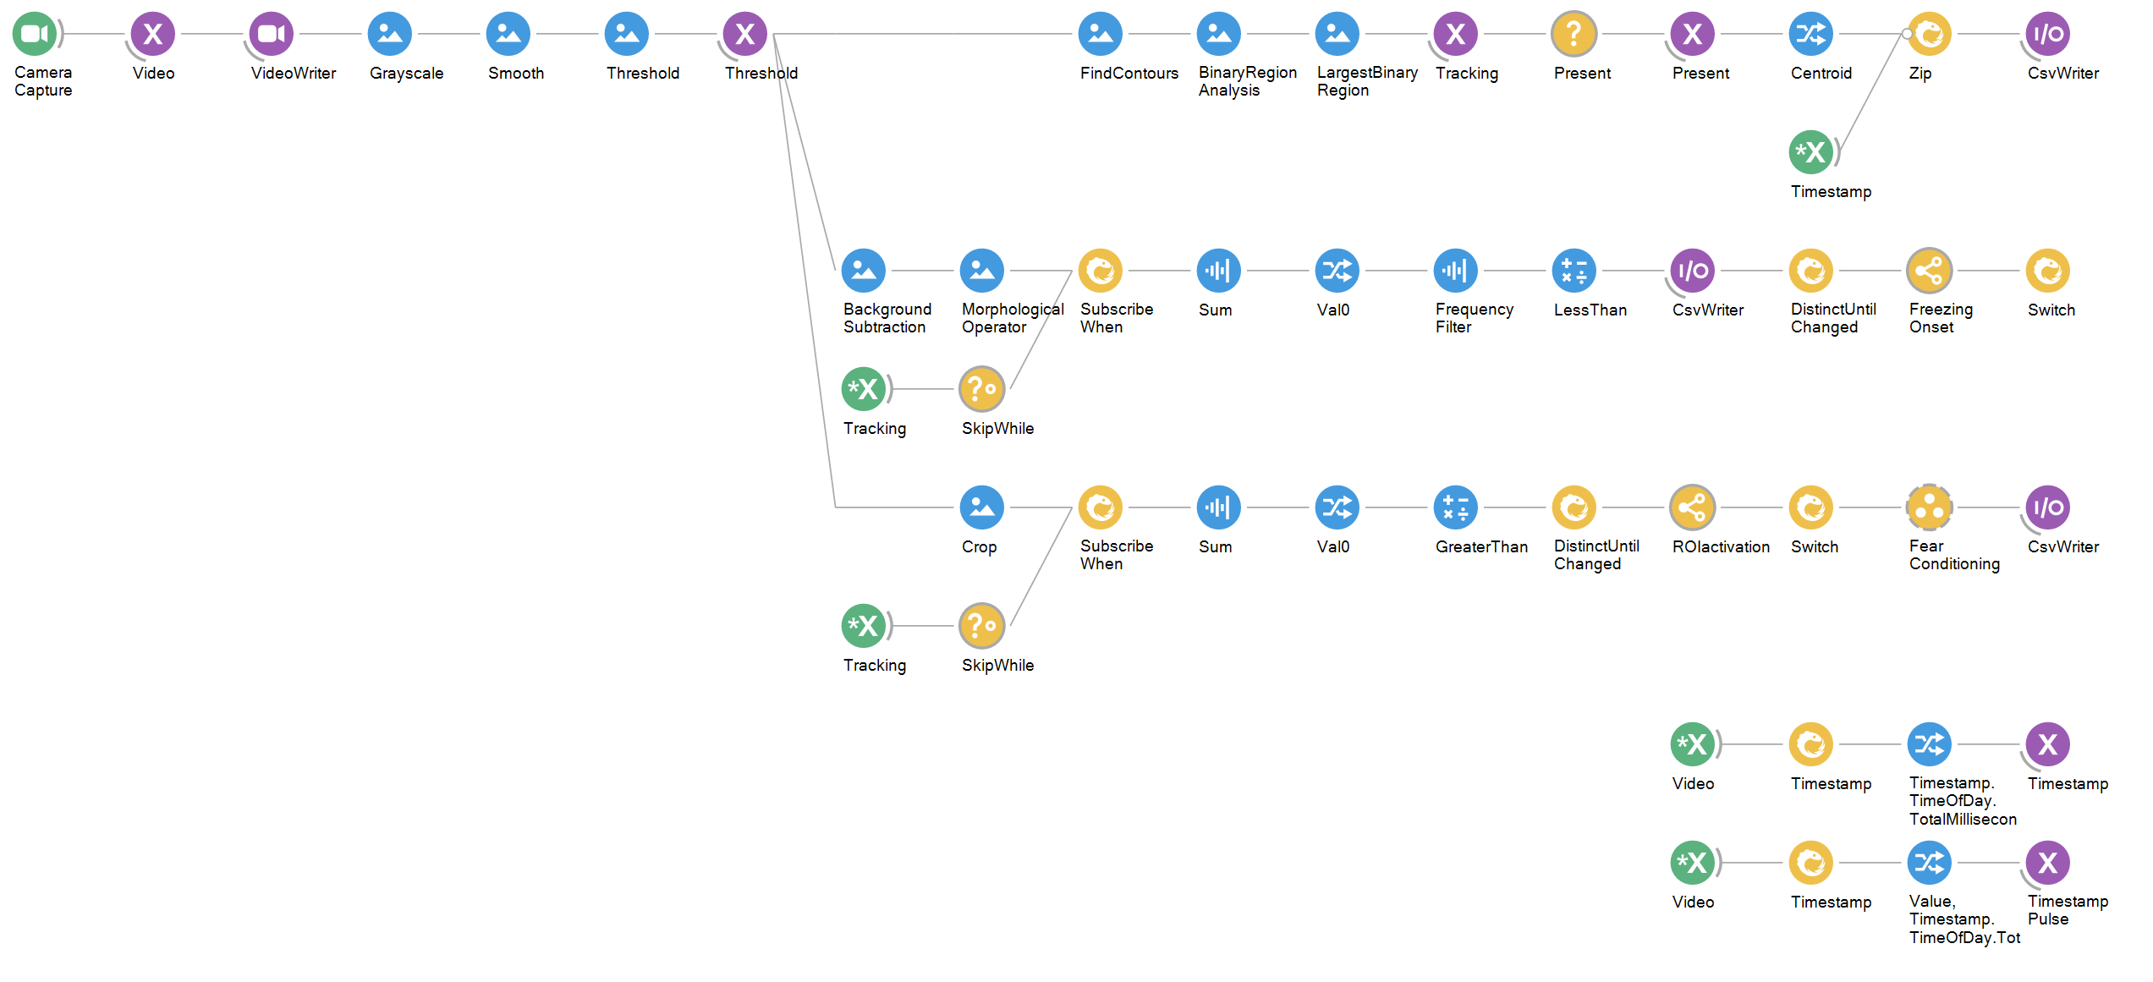
Tracking animal X and Y coordinate (ignore NAN) when animal is present (largest area pass certain threshold)
Detecting Freezing (sum of pixel change below threshold). Also, the animal has to be present (defined by largest binary region) for the freezing detection to precede (via SkipWhile)
When the animal stays in the region of interest (pixel sum reaches the threshold) for 2 seconds, it initiates the downstream fear conditioning workflow

Slide 3
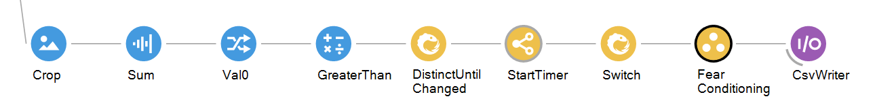
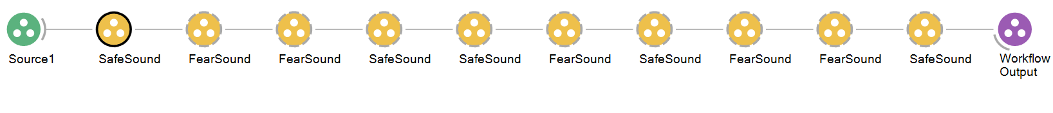
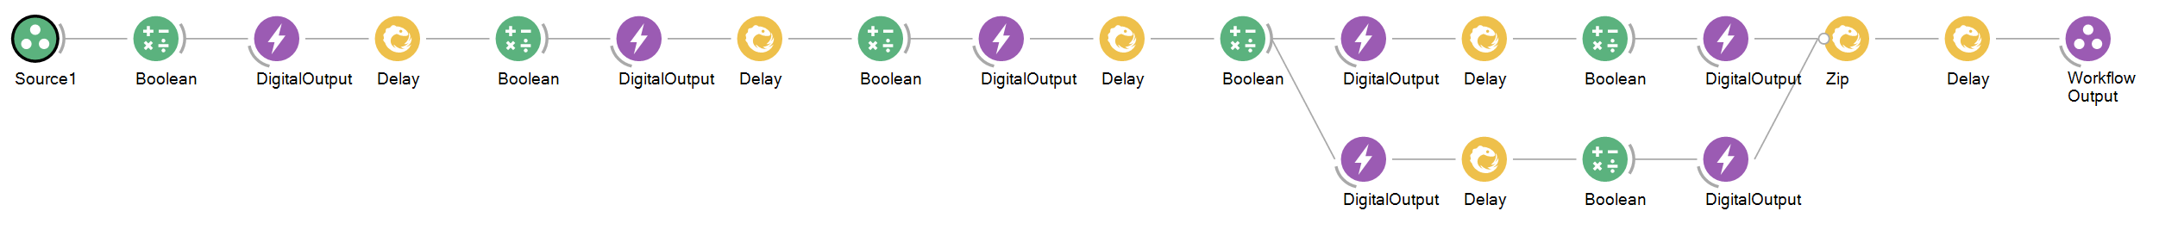
Sound ON 0.5 sec
Sound OFF
Wait
Start cue ON
2 sec
Start cue OFF
Wait
Sound ON 4.5 sec
Shock ON 0.5 sec
Shock OFF

